Slide 1


Erik Felëus
De Schiphol Smart AirportCity ambitie: Impact maken met volume!

Slide 2
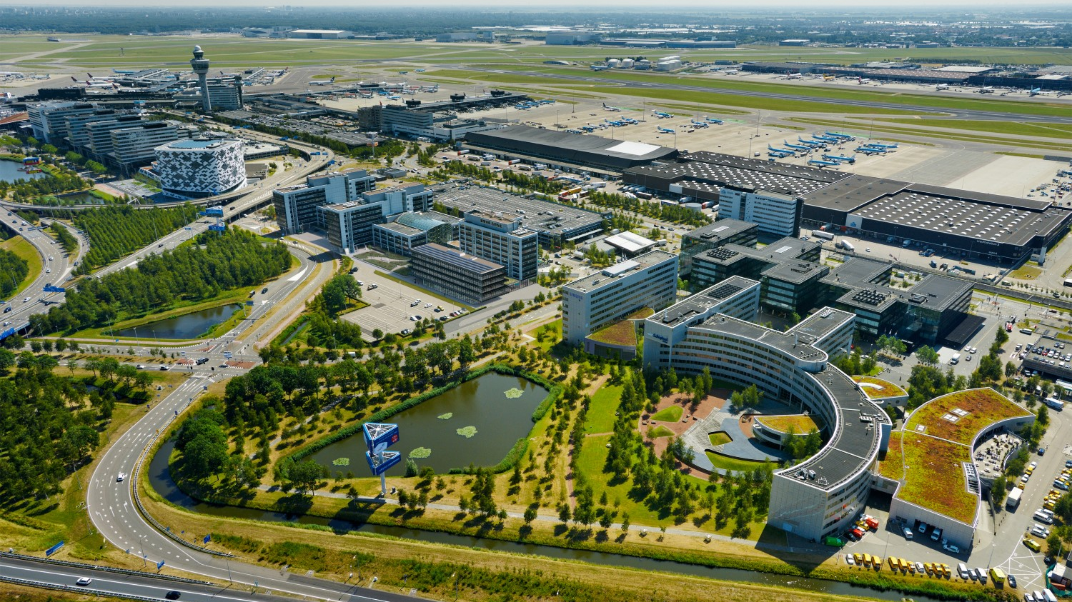
Schiphol Smart AirportCity
Erik Felëus
Schiphol Commercial
https://we.tl/t-BdcLxV1hQu
Your office at Amsterdam Airport

Slide 3
Agenda
Introduction
Schiphol
Airport City
Energy transition
Utilizing data

Slide 4
Introduction
Your office at Amsterdam Airport

Slide 5
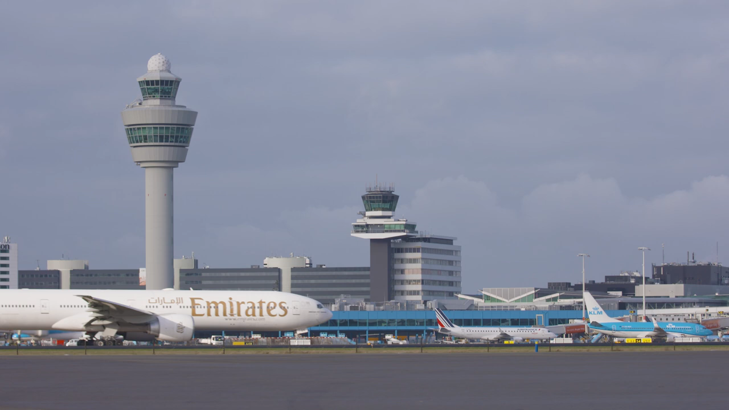

Slide 6

Onze strategie: Visie 2050
6

Slide 7
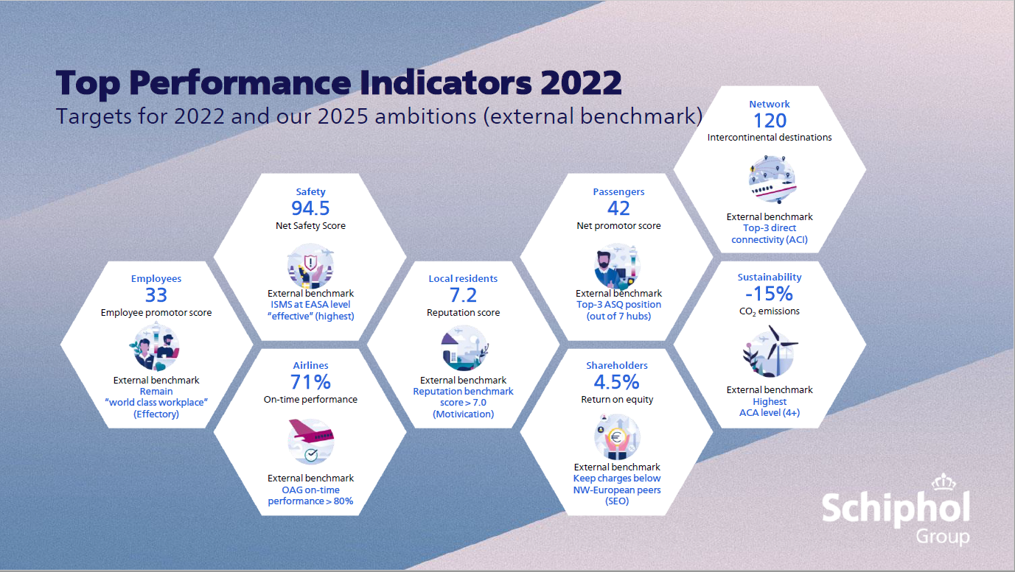
Top Performance Indicators resultaat 2021
7

Slide 8
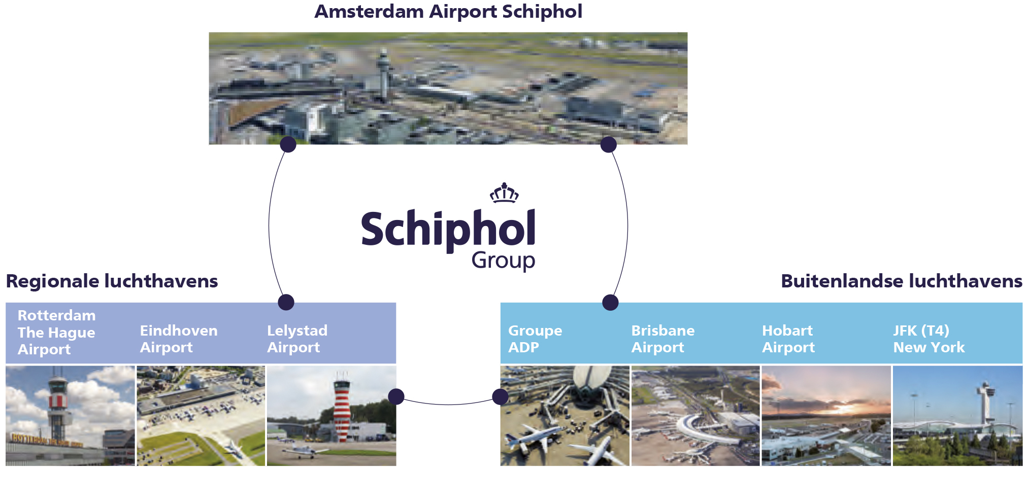
Royal Schiphol Group composition
Operator Amsterdam Airport Schiphol
Owner and operator of Rotterdam The Hague Airport and Lelystad Airport
Majority interest in Eindhoven Airport
Interest in Brisbane and Hobart airports
Terminal and retail operations management Terminal 4, JFK New York

Slide 9
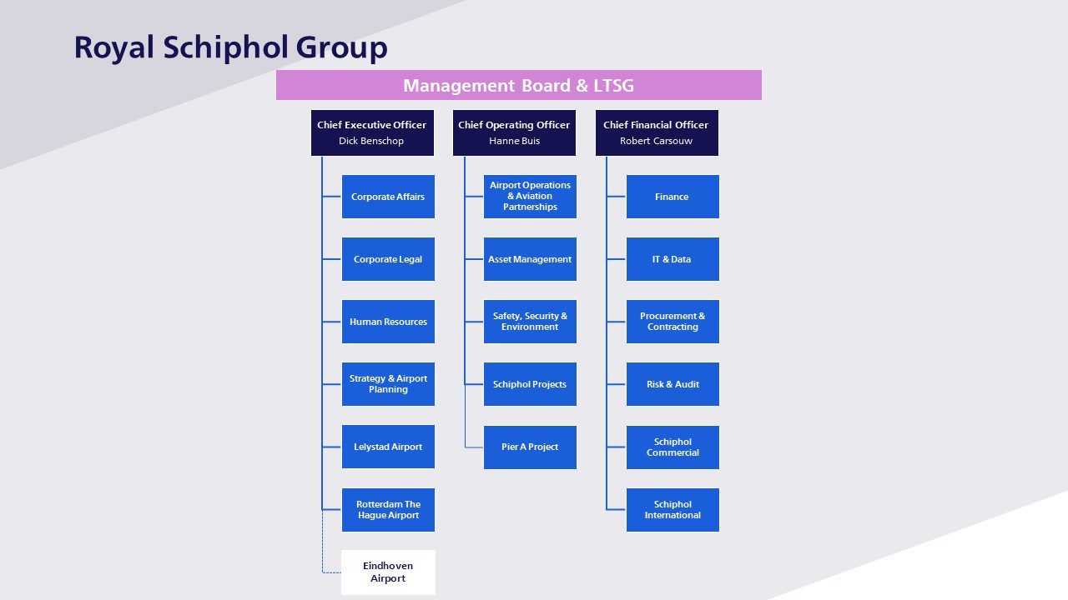
9

Slide 10
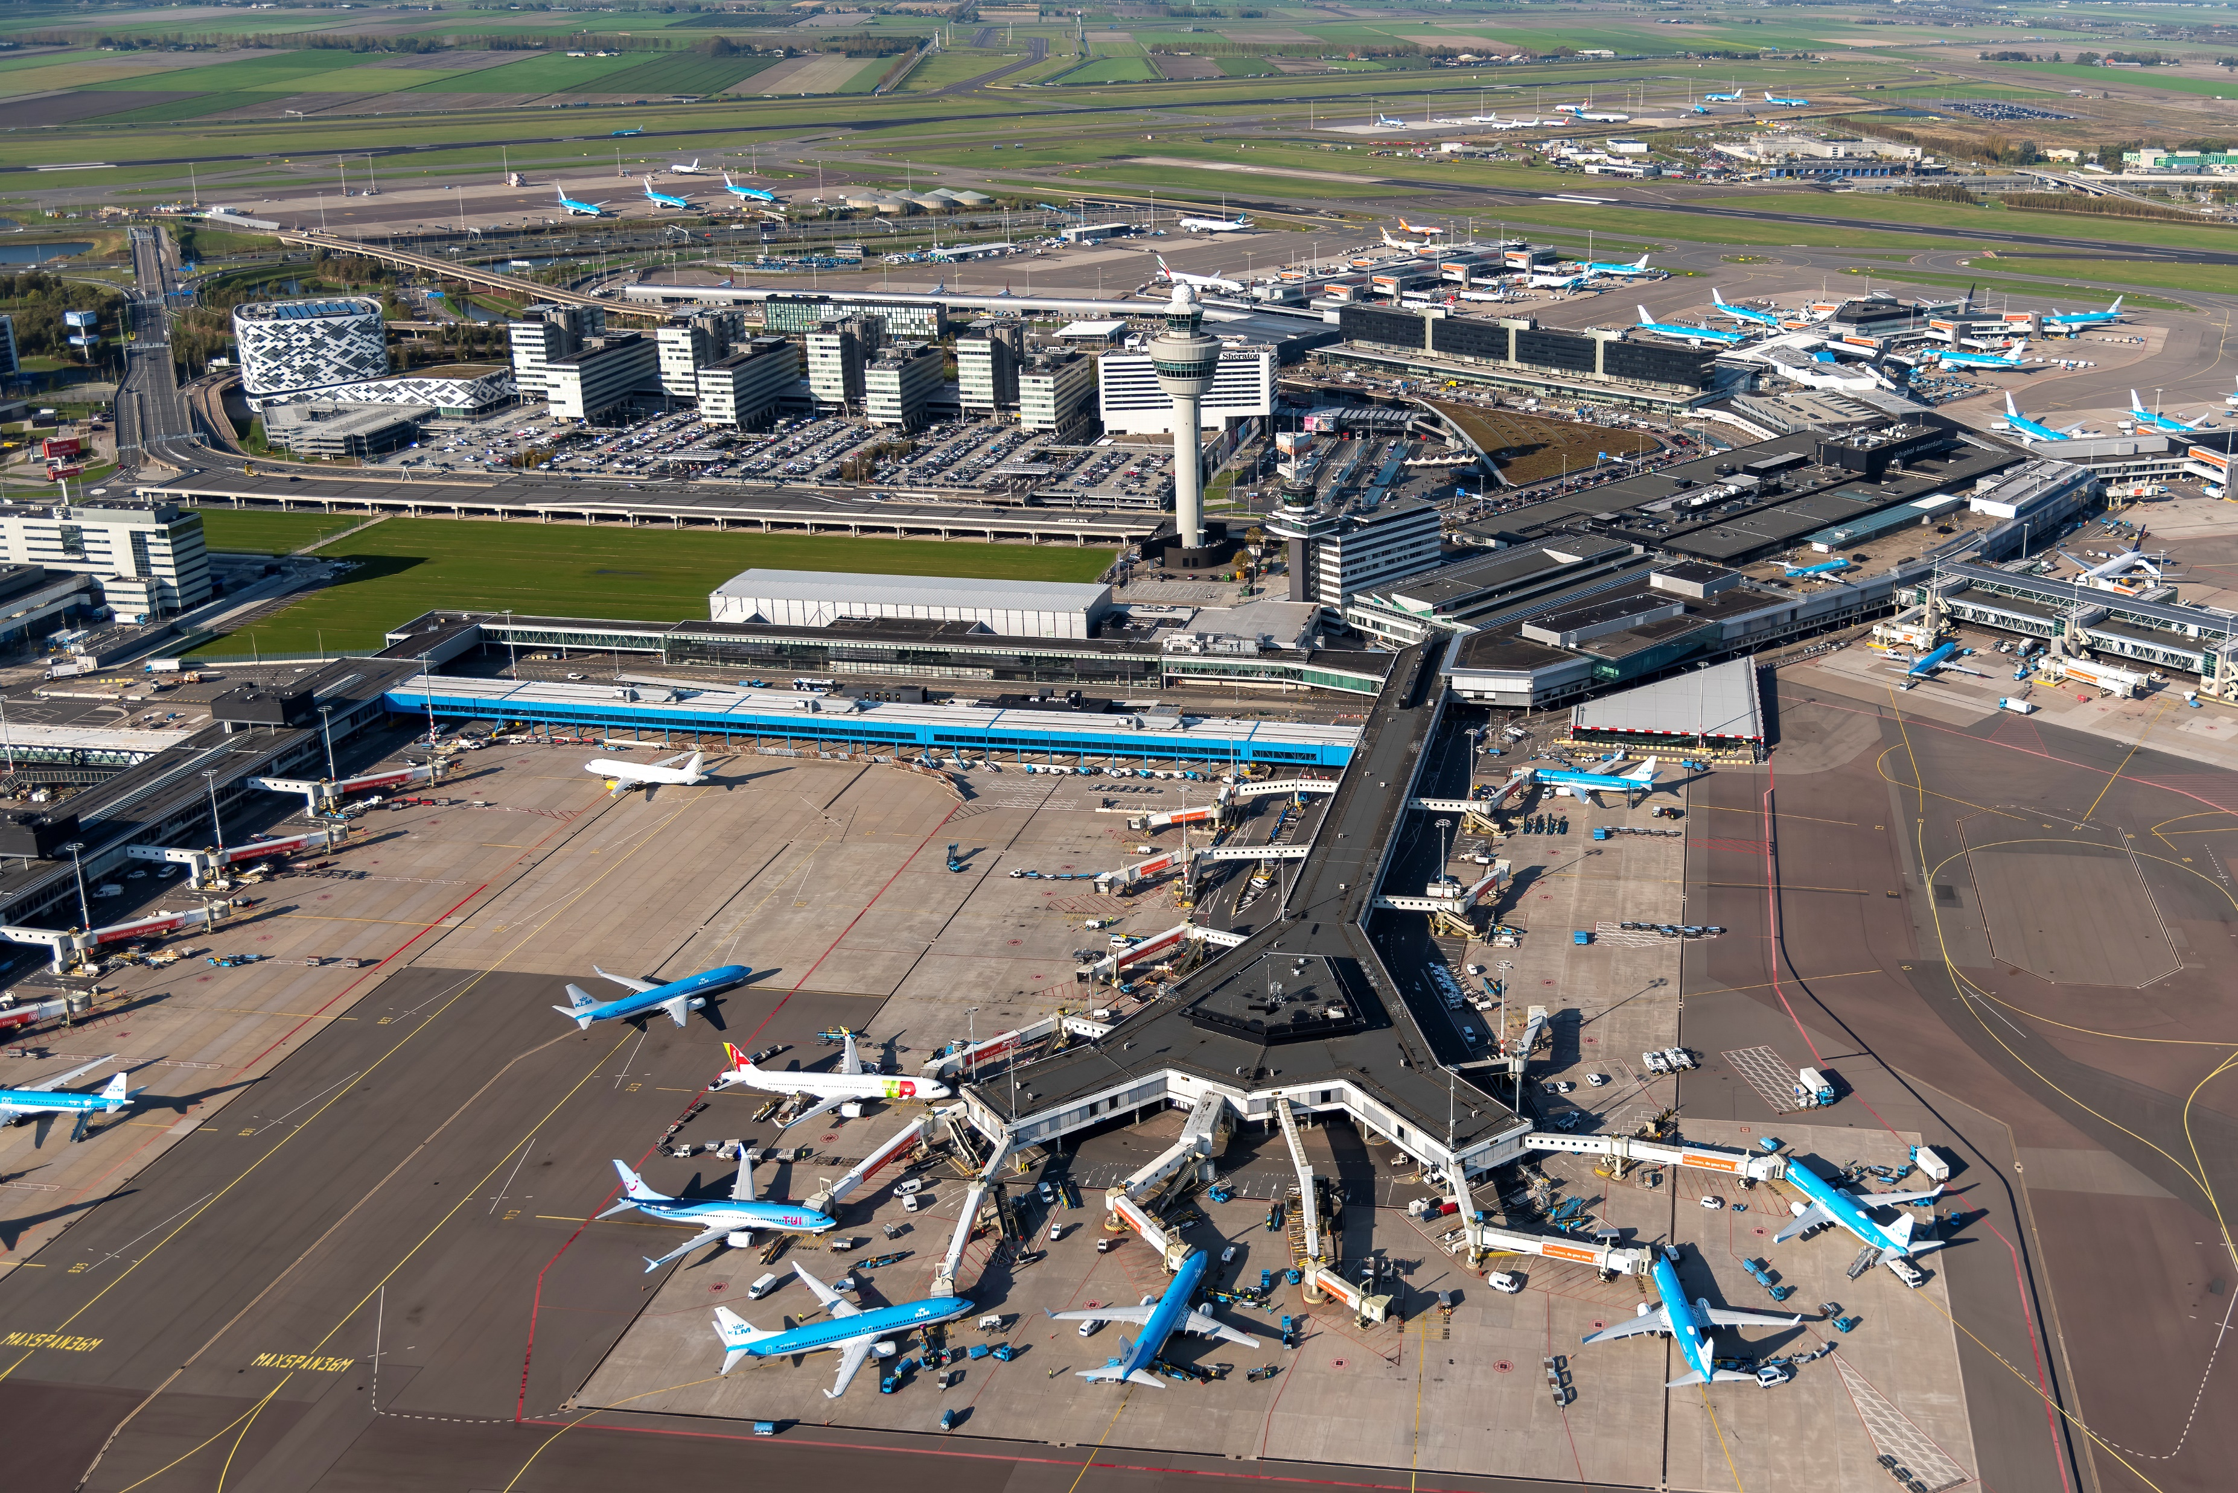
10

Slide 11
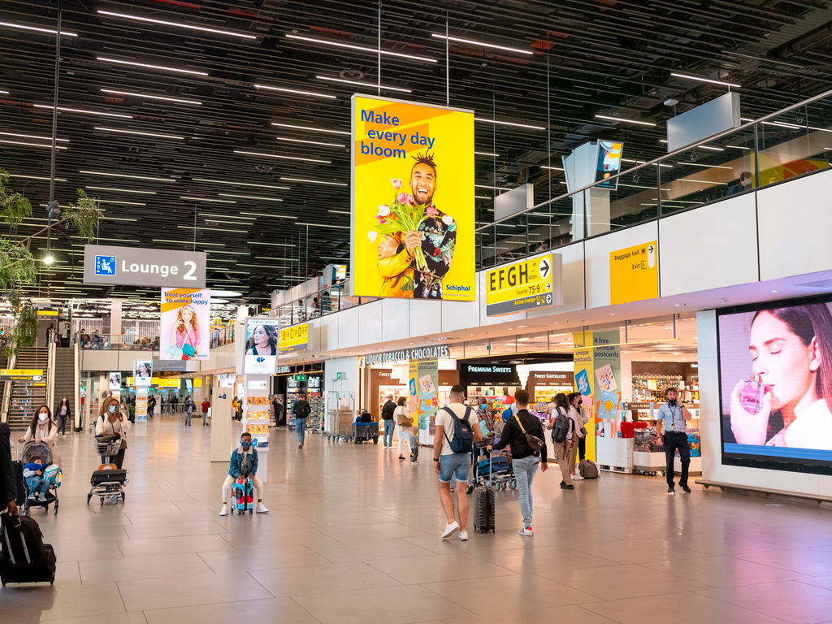
11

Slide 12
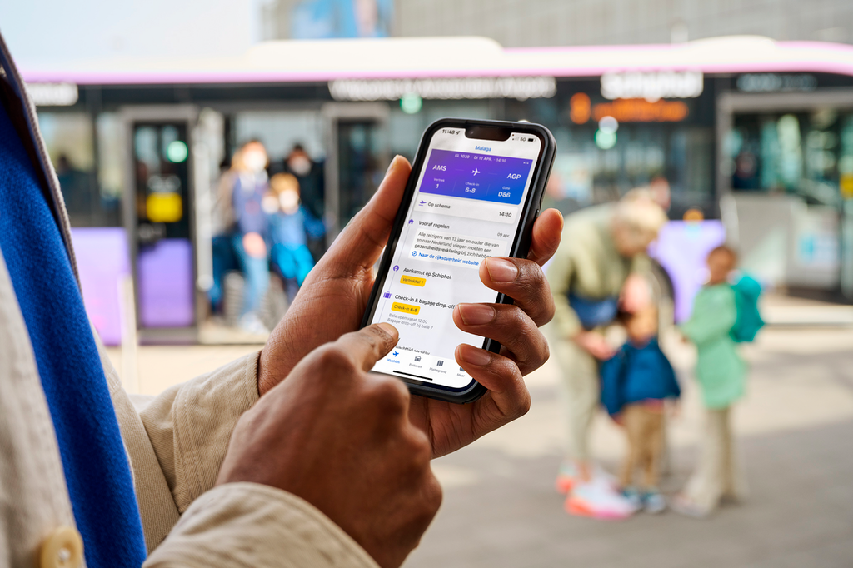

Slide 13

13

Slide 14
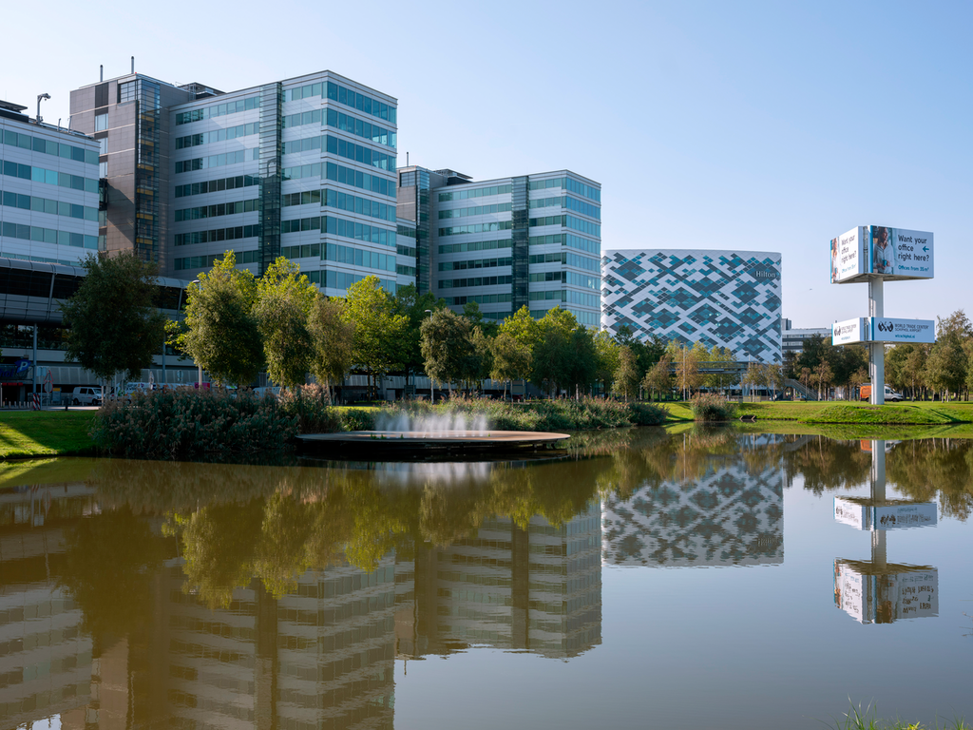
14

Slide 15
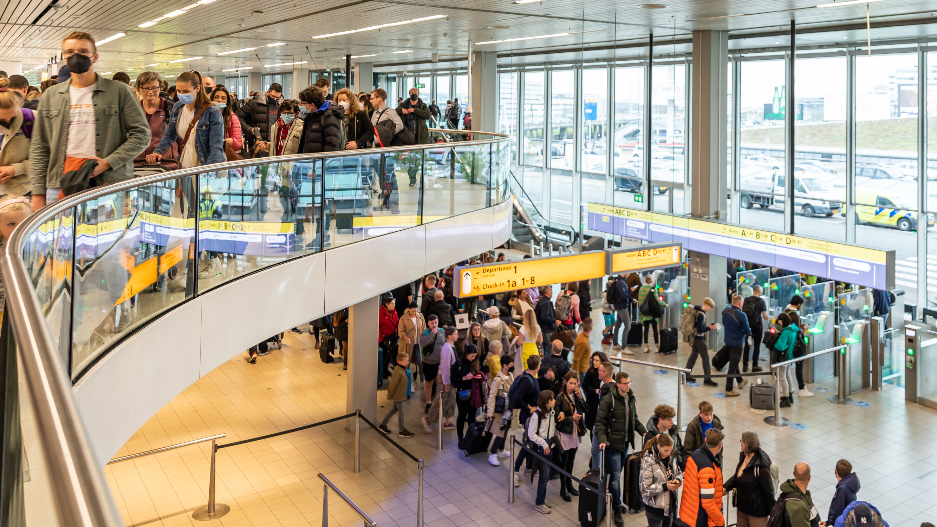
15

Slide 16
Schiphol Airport City
Your office at Amsterdam Airport
16

Slide 17
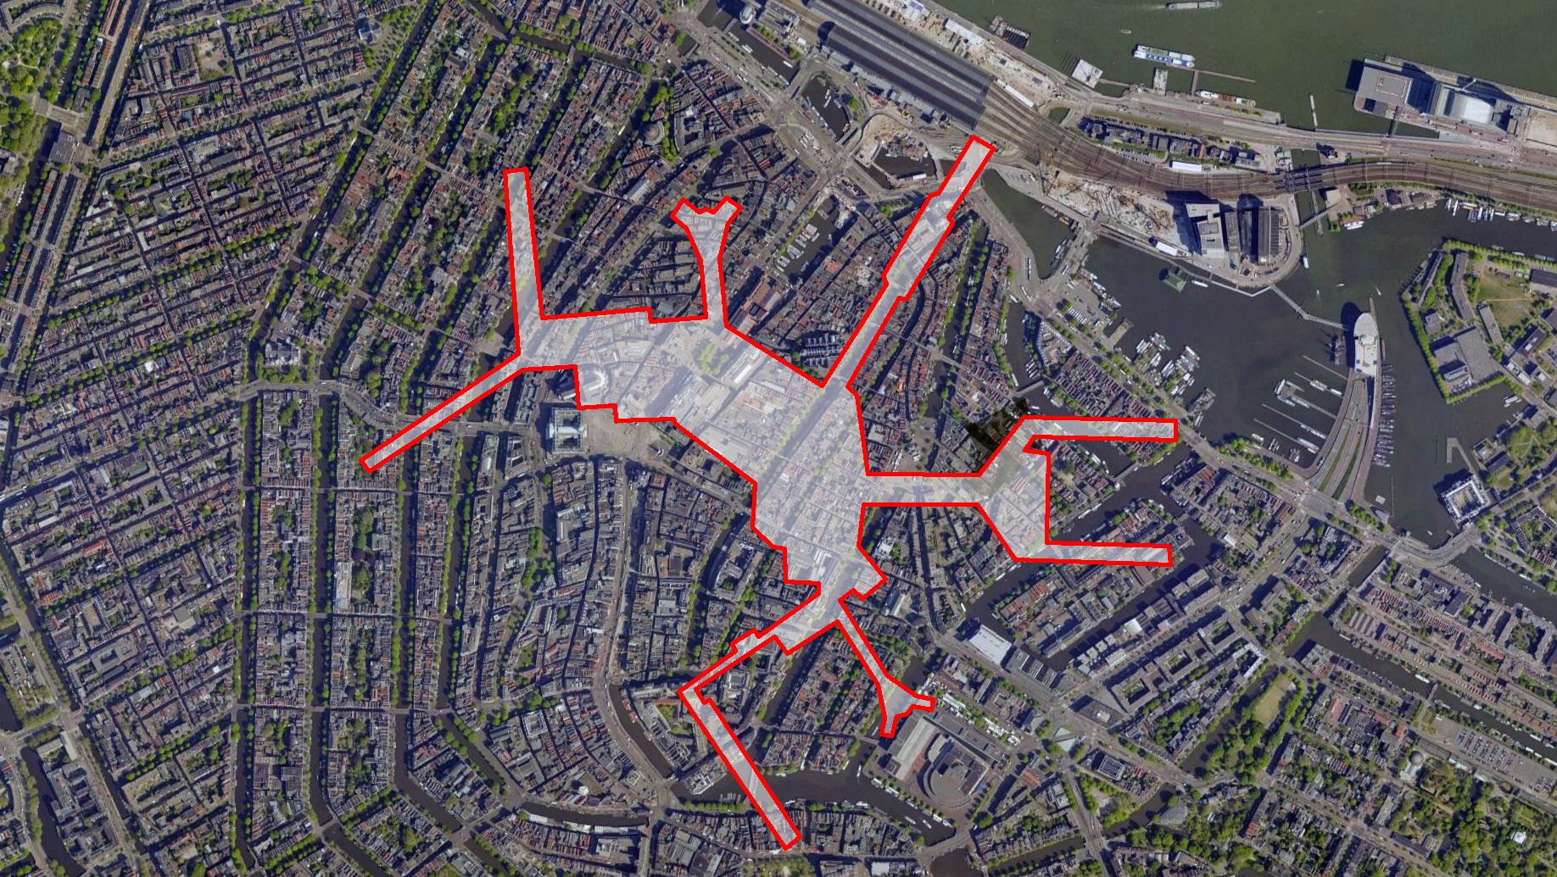
LET’S
THINK
FROM A
AIRPORT CITY APPROACH

Slide 18
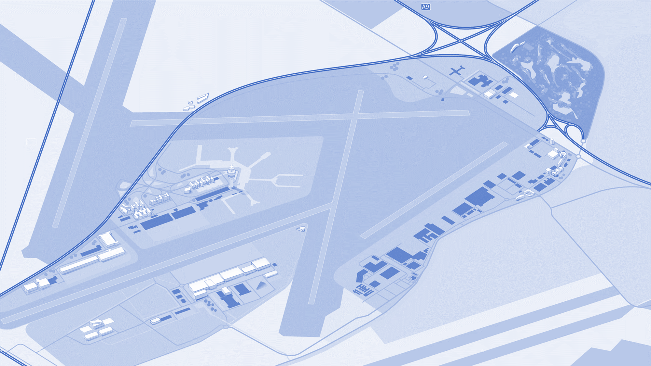


















Areas
North/Northwest
East
CBD
Terminal
South/Southwest

Slide 19

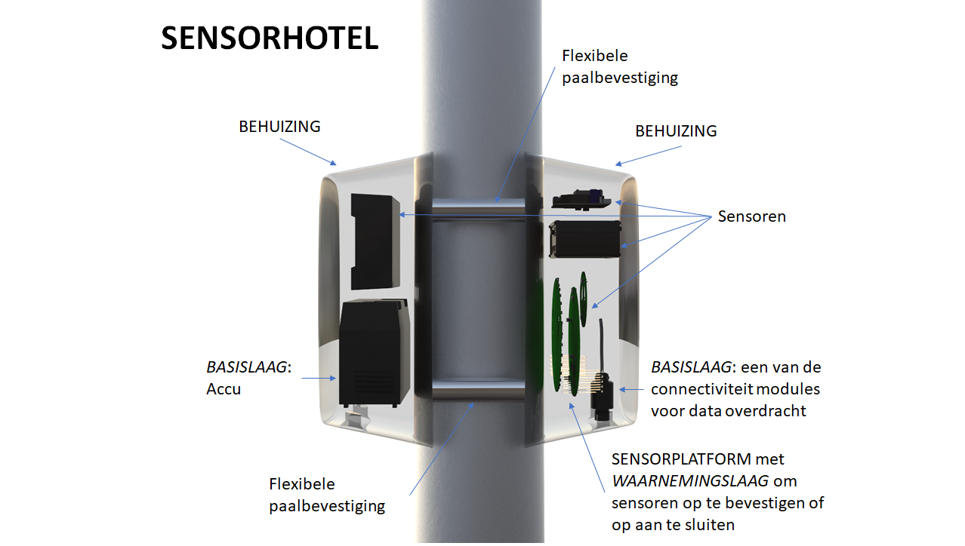
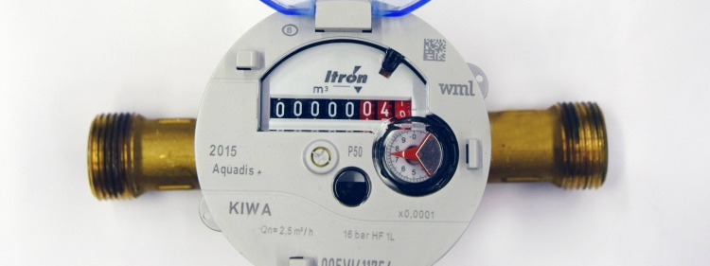
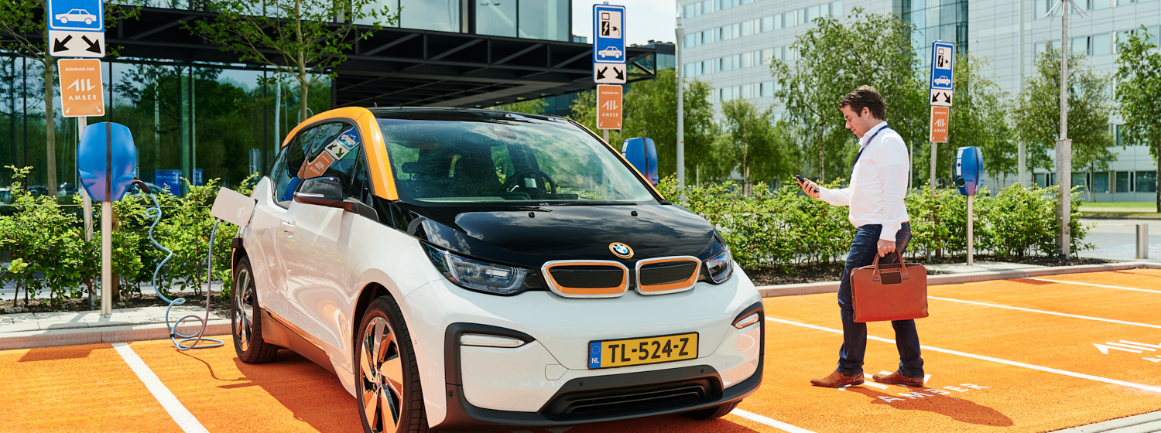

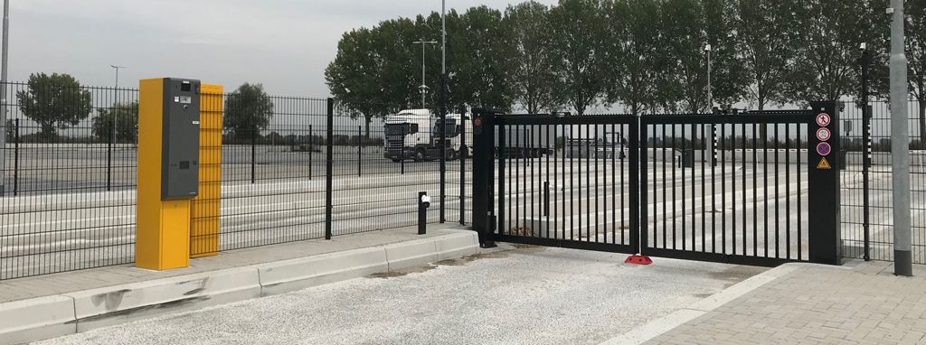
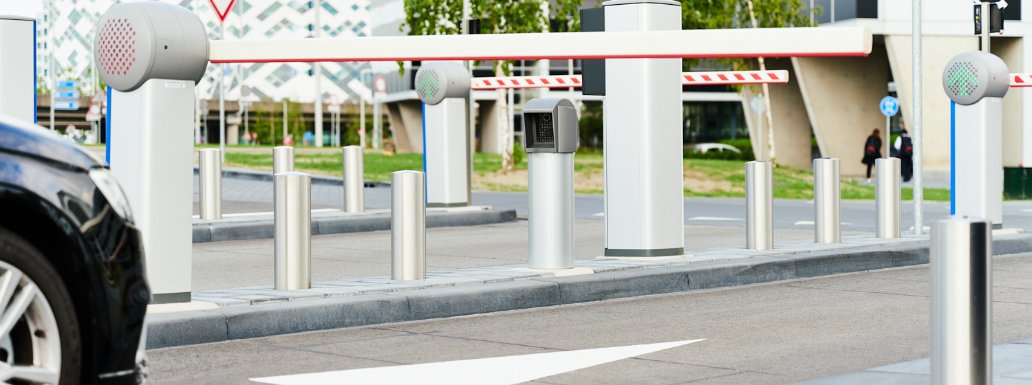


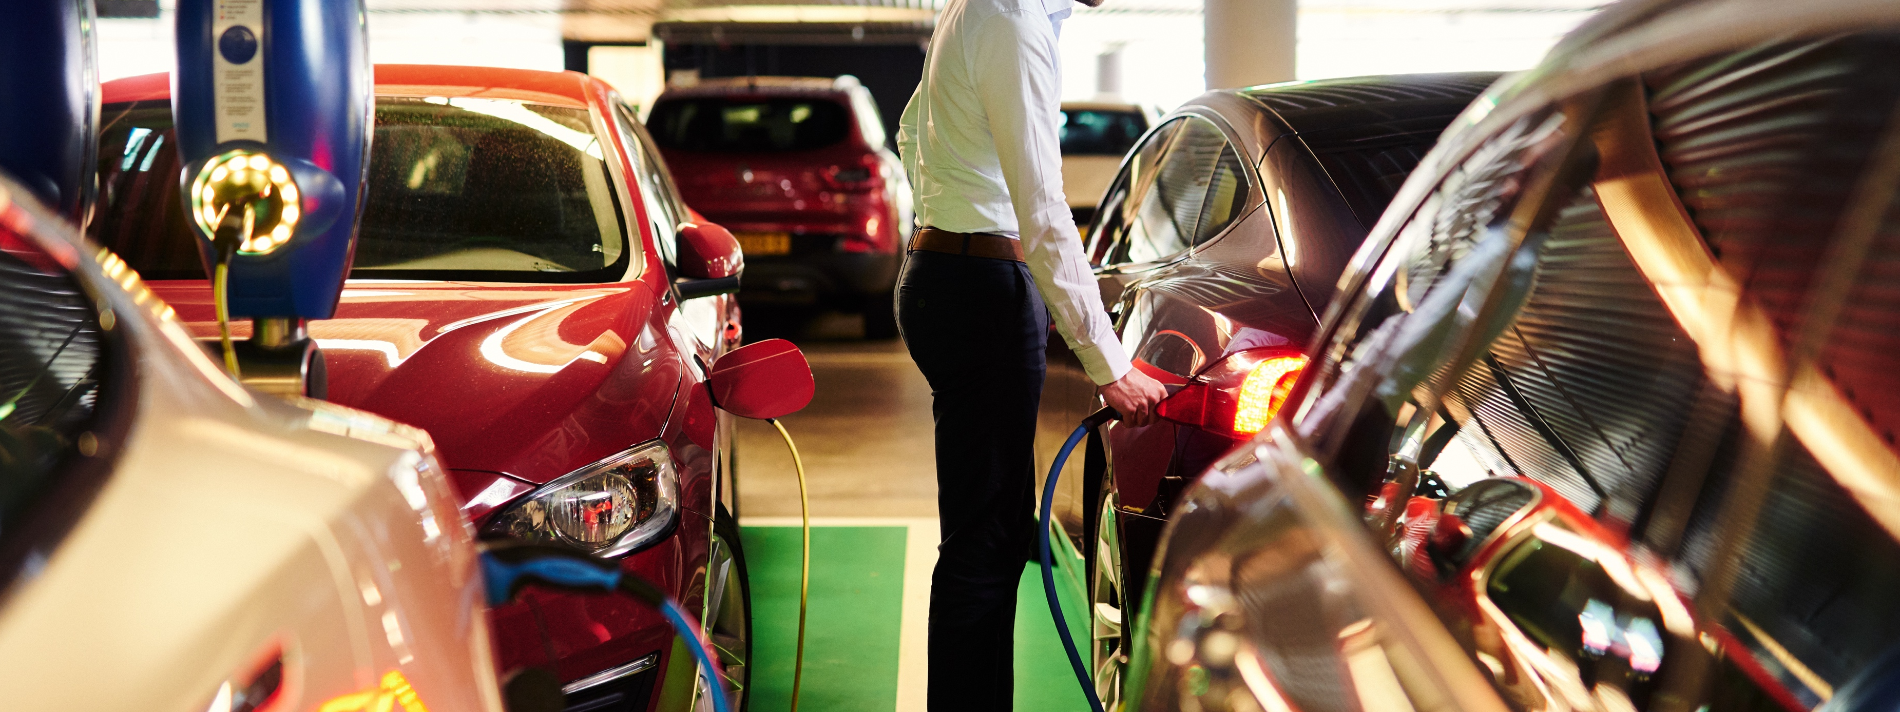
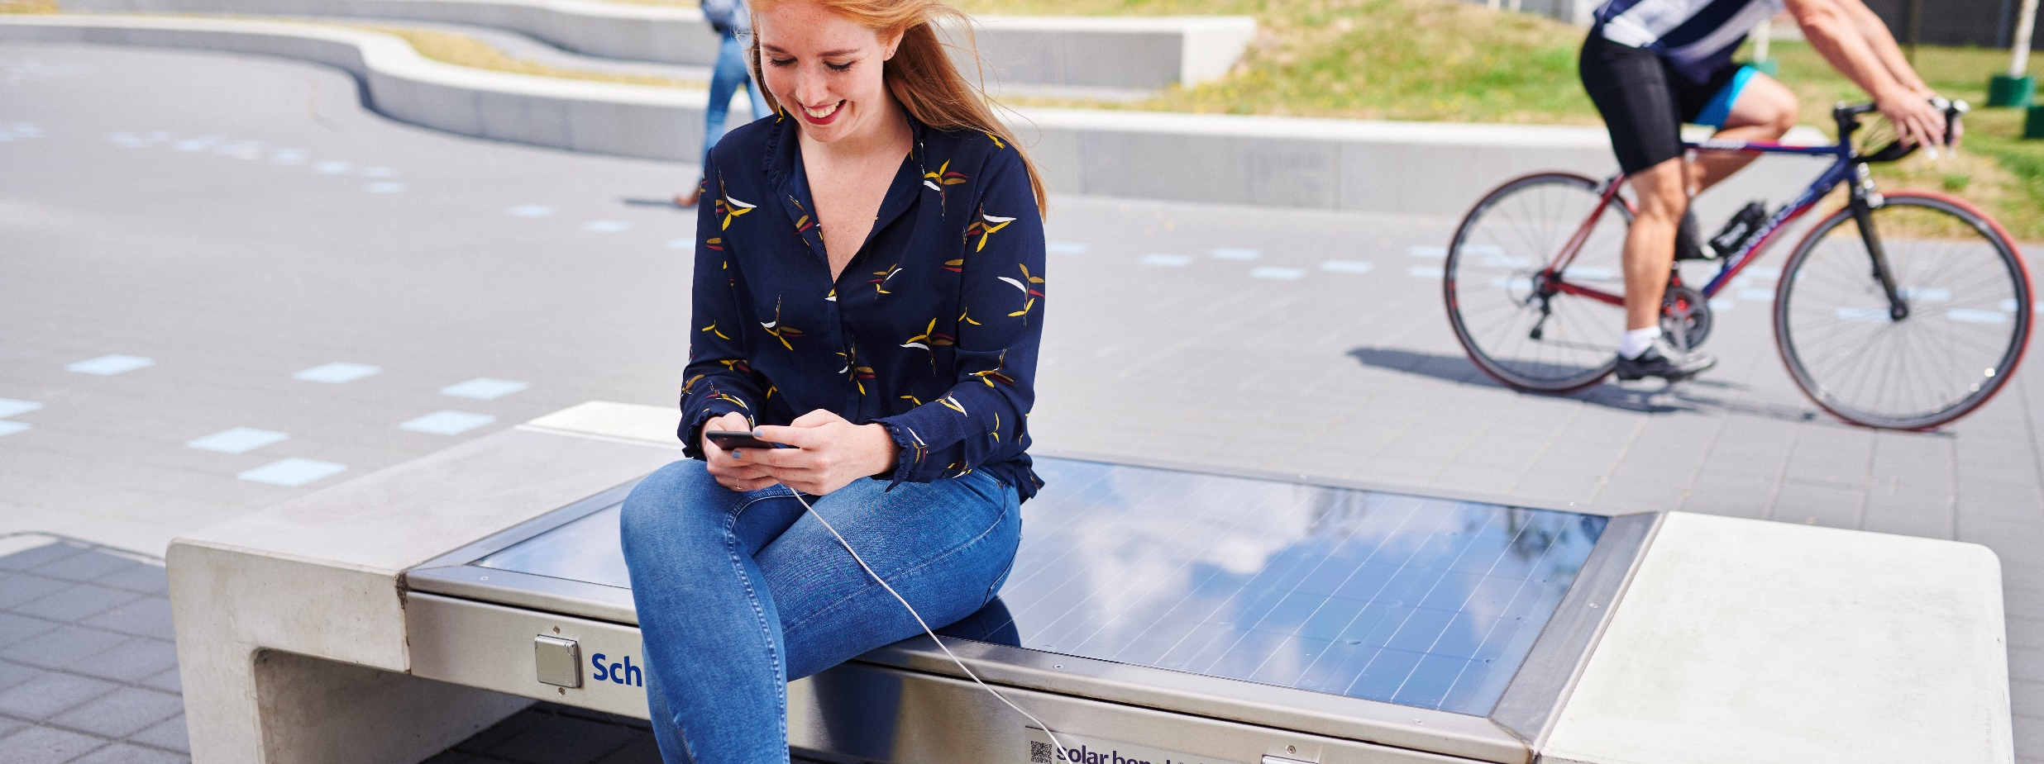
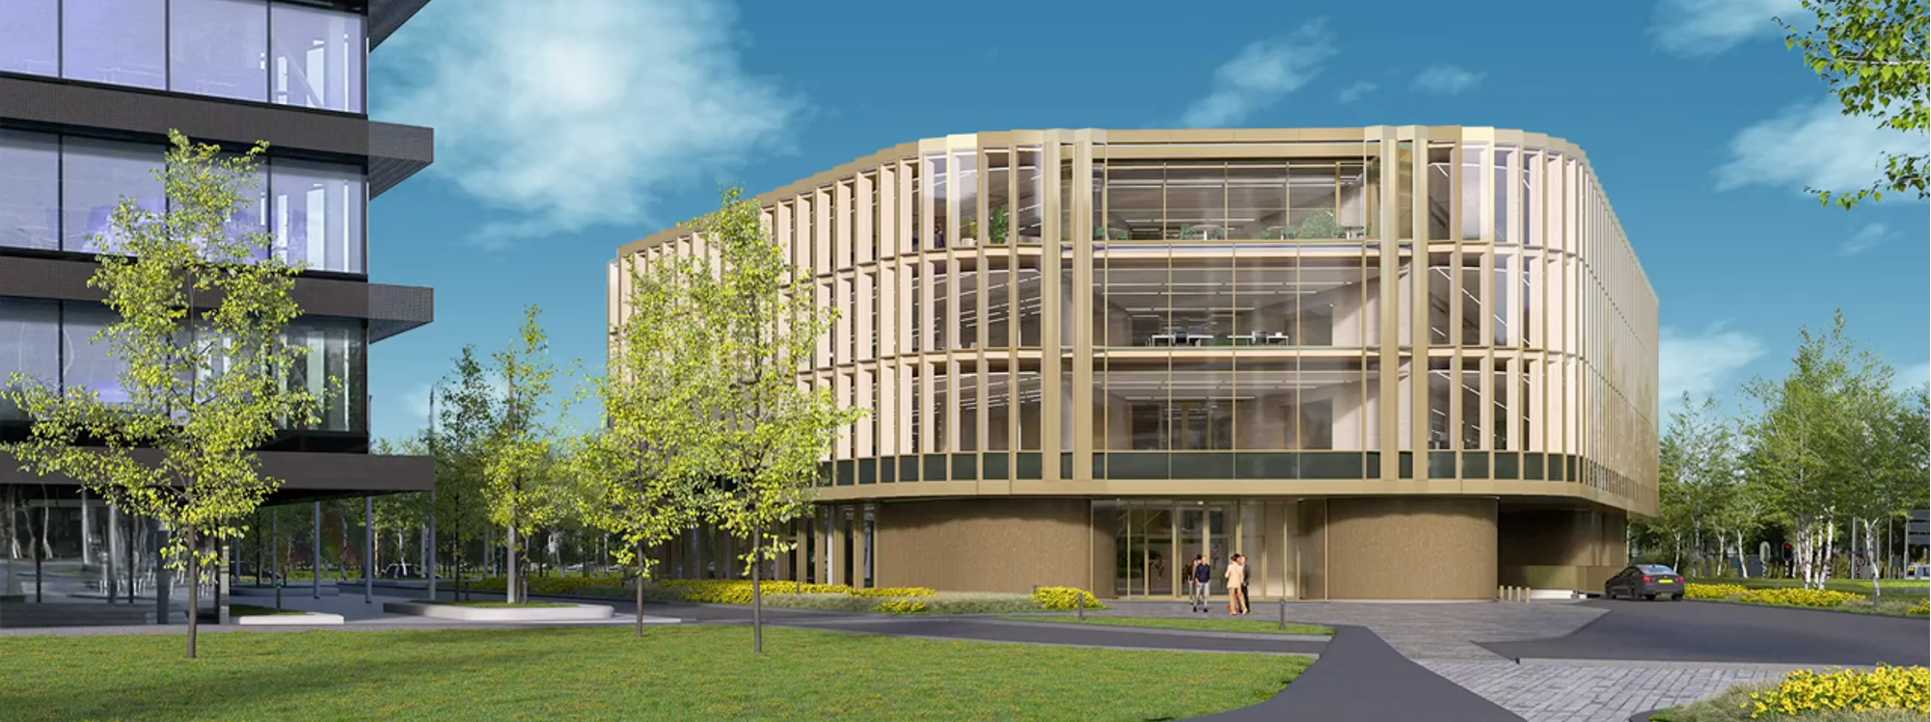
Schiphol Smart Airport City Development
Smart Climate Control
Particulate Matter (PM10)
Smart Water Meters
Smart Mobility
Predictive Maintenance Elevators
Just In Time Trucking
Smart Parking
Smart Waste Management
Smart Energy Metering
Smart Charging
Smart Grid Load Balancing
Digital Twin / BIM 3D

Slide 20
Energy
Transition
Your office at Amsterdam Airport
20

Slide 21
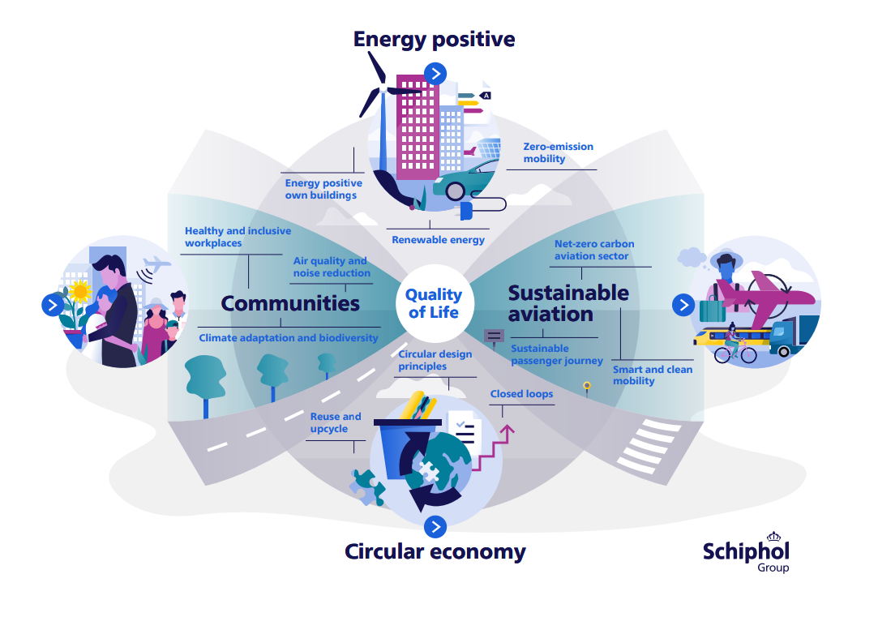
Mind your step 1

Slide 22




Mind your step 1
Zero Emission 2030:
Phase out gas by executing ATES strategy
‘Paris Proof’, energy use of 70 kWh/m²

Slide 23
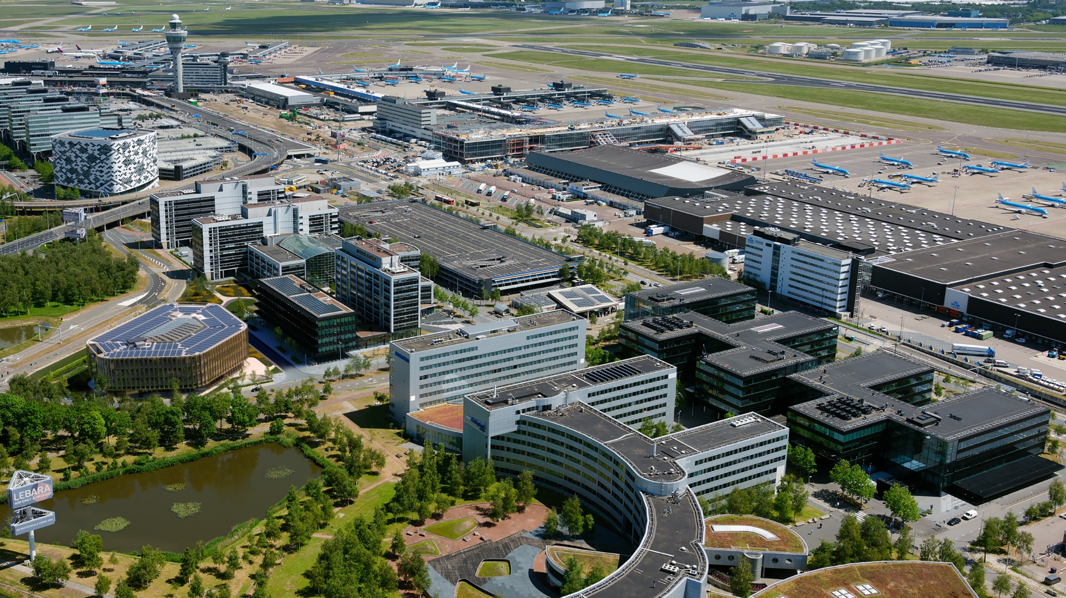
Mind your step 2
Scope and influence

Slide 24
Portfolio overview
Schiphol Real Estate
213,295 sqm
274,407 sqm
104,642 sqm
59,013 sqm
Operational Real Estate Terminal
104,642 sqm
Offices
213,295 sqm
651.357
sqm
45+ objects
Freight
274,407 sqm
Source: Control SRE 2021

Slide 25
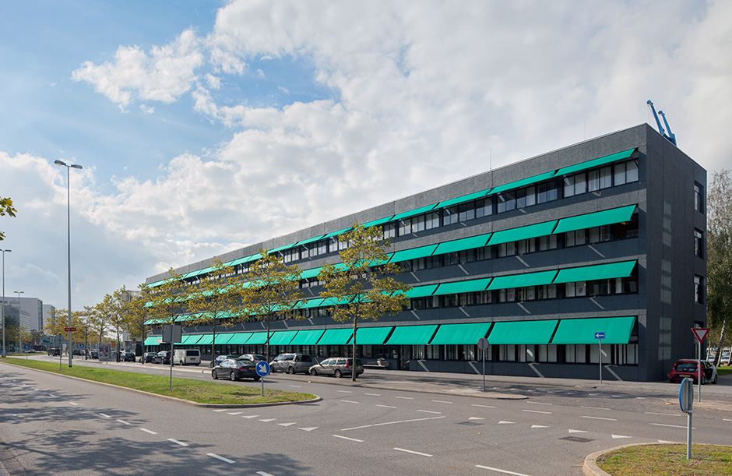
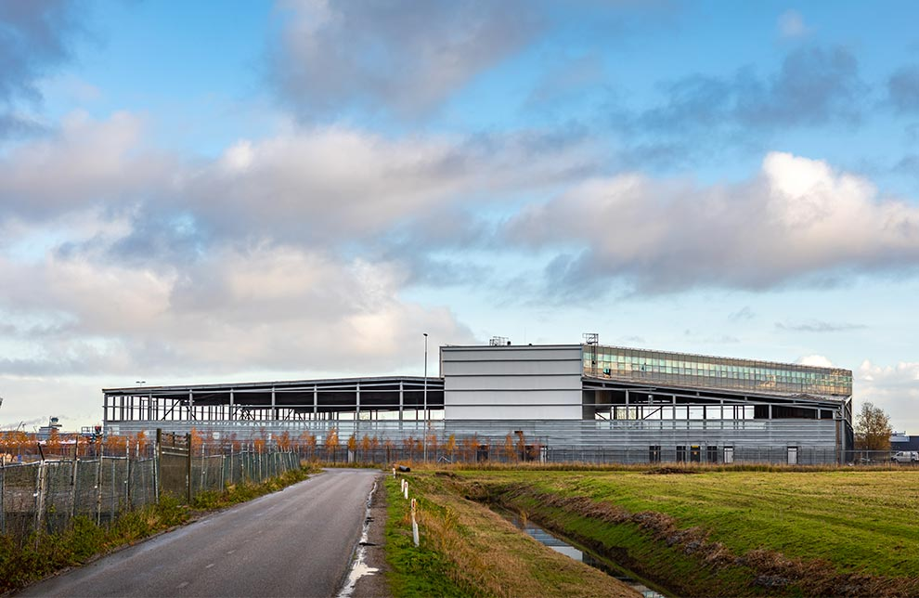
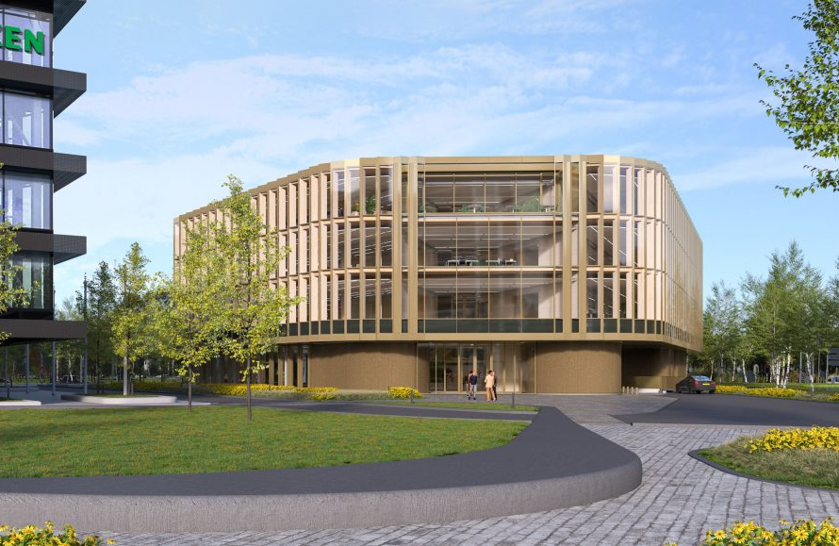
Mind your step 3
Real estate strategy
Area strategy
Life cycle
Quality / investment level

Slide 26
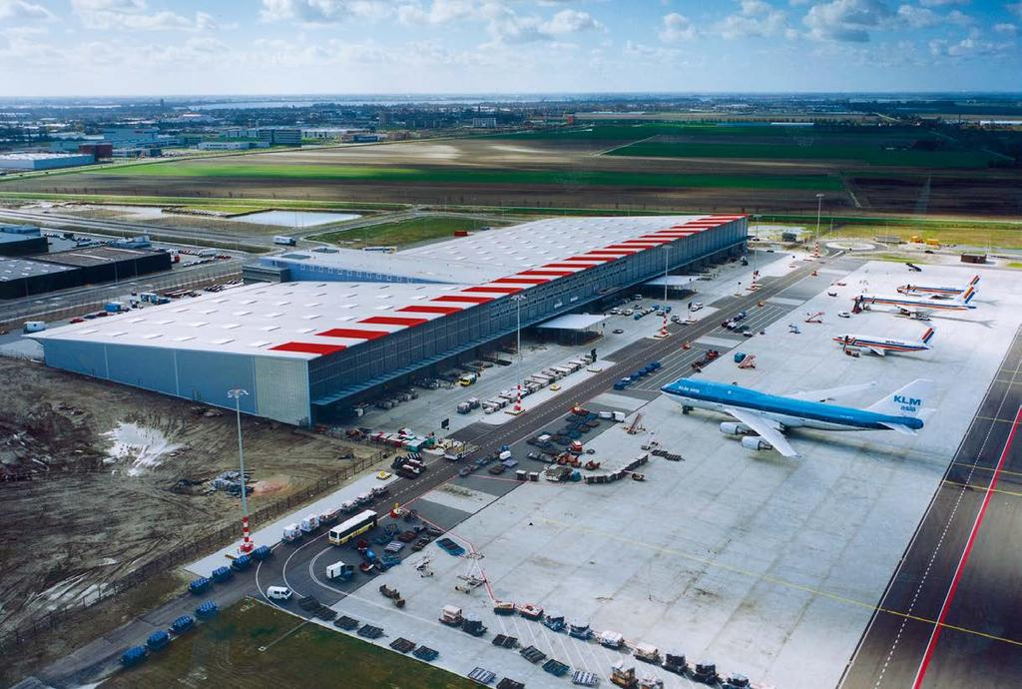
Mind your step 4
Property level
Prevent unnecessary energy use
Improve facades & roofs
Improve & renewing building installations
Sustainable heat & cold generation

Slide 27
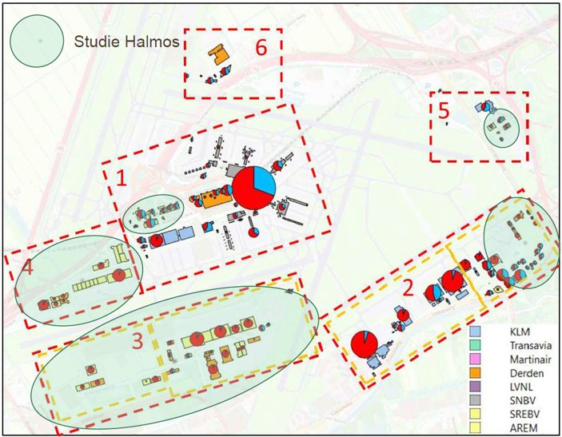

Mind your step 5
Area level

Slide 28
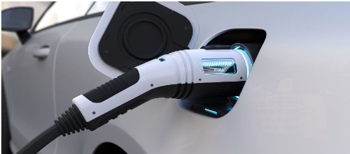
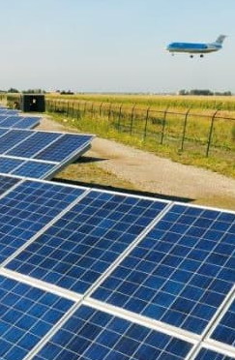
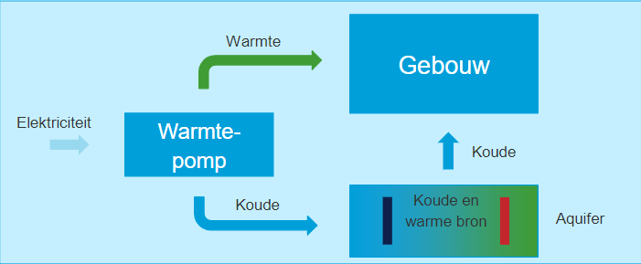
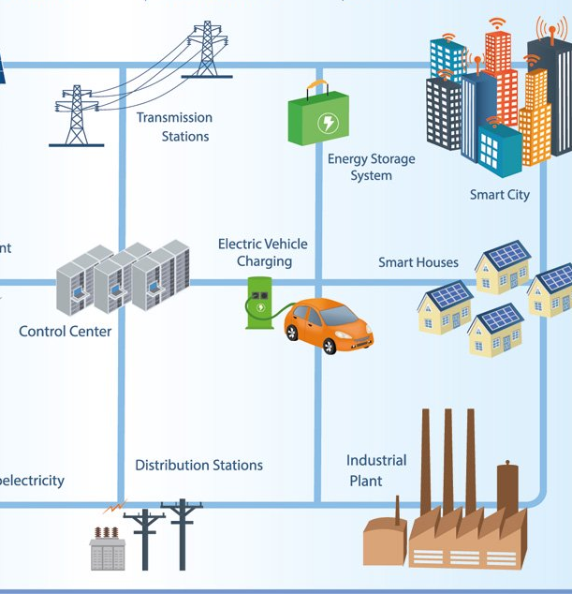
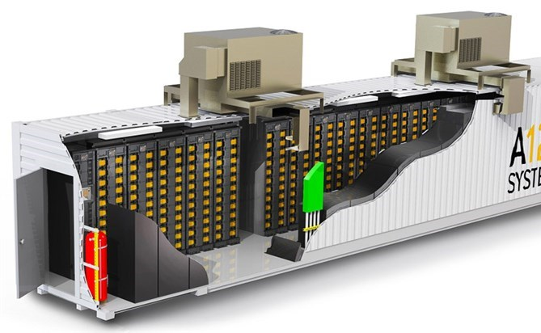
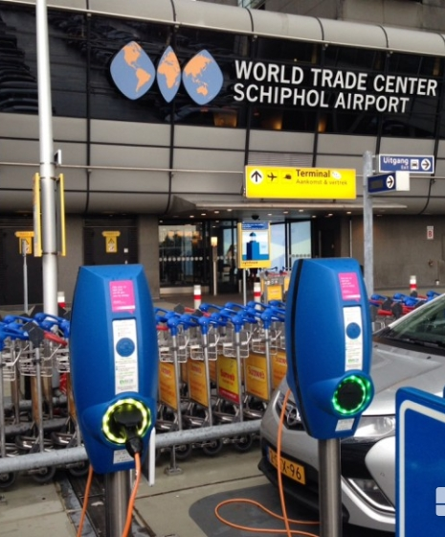
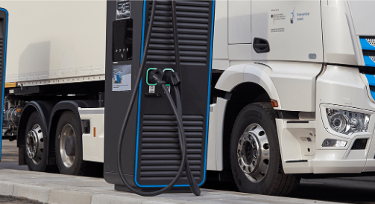
Mind your step 6
Enlarge and utilize your solutions space
Supply
Demand
Storage
Smart Energy Hub
Enter into new collaborations: Airport City Management 2.0

Slide 29
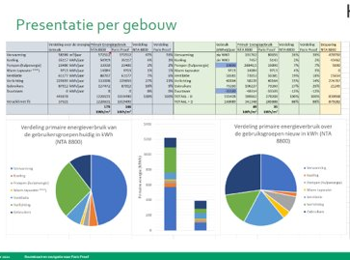
Mind your step
Vision
Vision: most sustainable Airport City
Scope and influence
Real estate strategy
Property level
Area level
Enlarge and utilize your solutions space
DMJOP
Airport City

Slide 30
Utilizing data
Your office at Amsterdam Airport

Slide 31










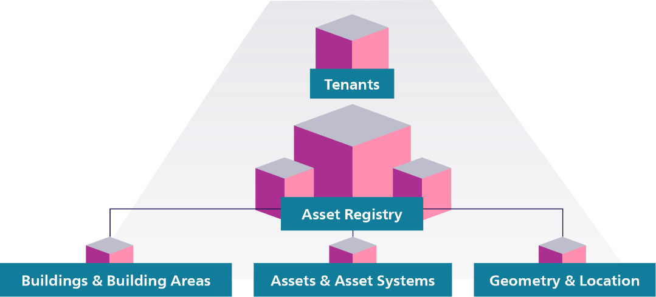


















Smart
Building
Reference
Architecture
Users
Startups
Tenant Systems
Other
Residents
Tenants
- Portfolio Management
- Strategy Office
- Business Development
Open API’s
Live Building
Narrowcasting
Reporting &
BI Dashboard
Live
portfolio
Distribution
Analytics
Complex Event Processing
GeoAnalytics
AI & Machine Learning
Business Rules
BI & Data warehouse
Smart
Building
Data
Data Storage & Streaming
Flow & Occupancy
Incident
Parking
Climate
Condition / Maintenance
Other
Energy Consumption
Ingestion & Validation
Batch
Periodically Forwarded
Data Dictionary
Streaming
Immediately Forwarded
Sources
Buildings
Financial
Management
Systems
Facility
Management
Systems
Building
Management
Systems
Internet of
Things
Building
Analytics
Systems
Asset
Configuration
Systems
Other
31

Slide 32
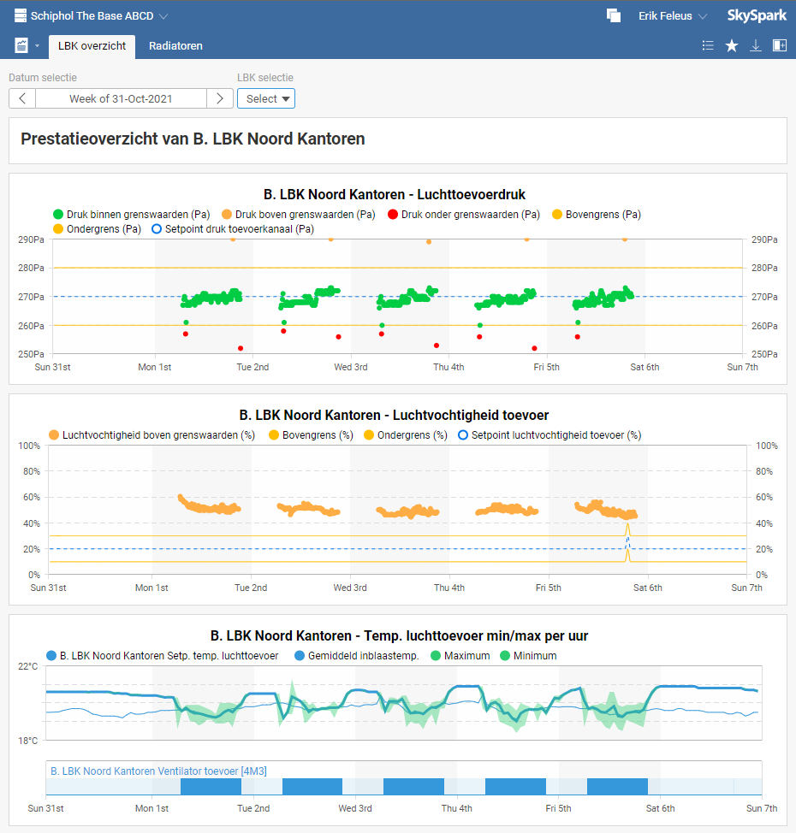
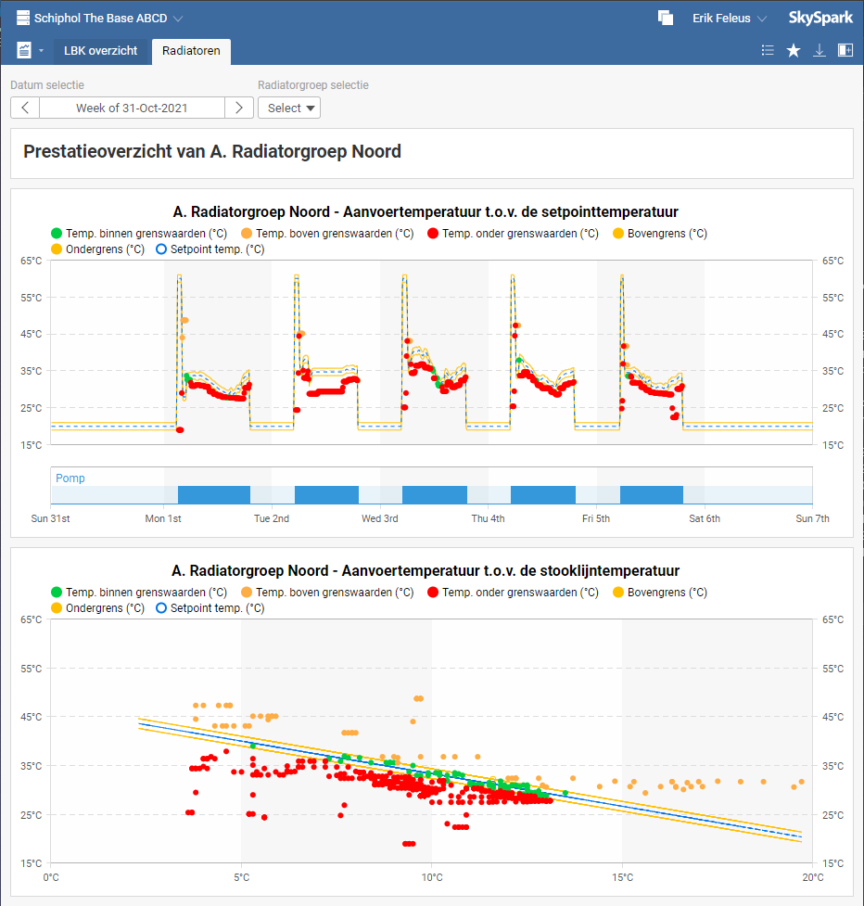
Data source 1 - BMS approach

Slide 33
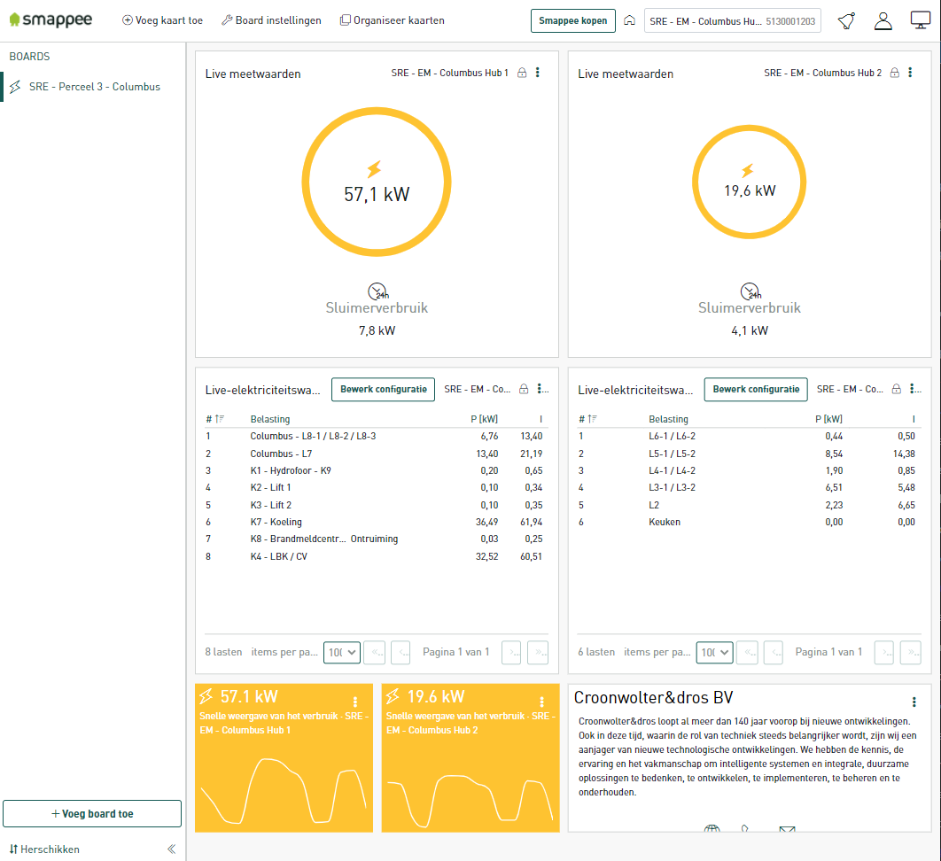

Data source 2 - Energy montoring

Slide 34
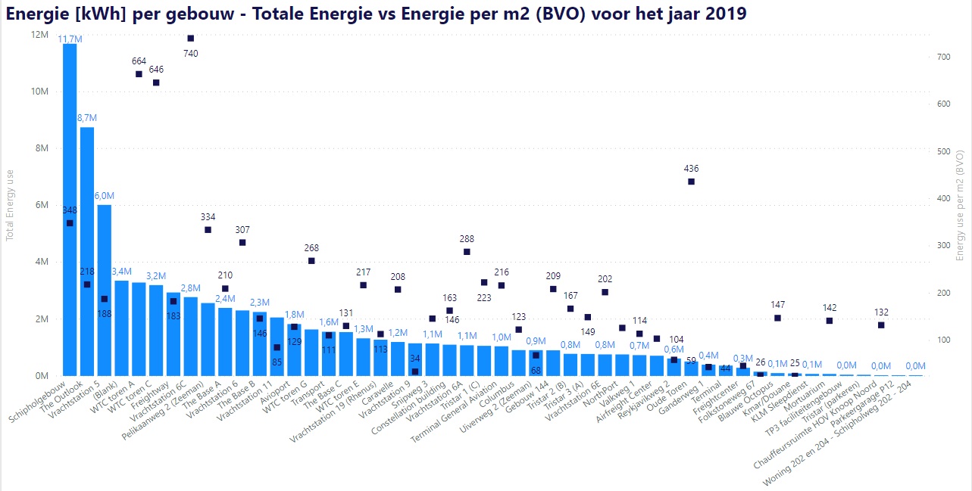
Data insight: Energy Consumption
Question 1:
What are the largest energy consumers in my portfolio?
The 3 buildings with the greatest energy consumption are SHG, Outlook and Vrachtgebouw 5
However, they score quite well on energy per m2
WTC A & C and Vrachtgebouw 6c, on the other hand, are both considerable in total consumption and in consumption per m2
Logically, these buildings would be the focus for energy-reducing initiatives
TBD
xx
Energieverbruik totaal (kWh)
Energieverbruik per m2 (kWh)

Slide 35
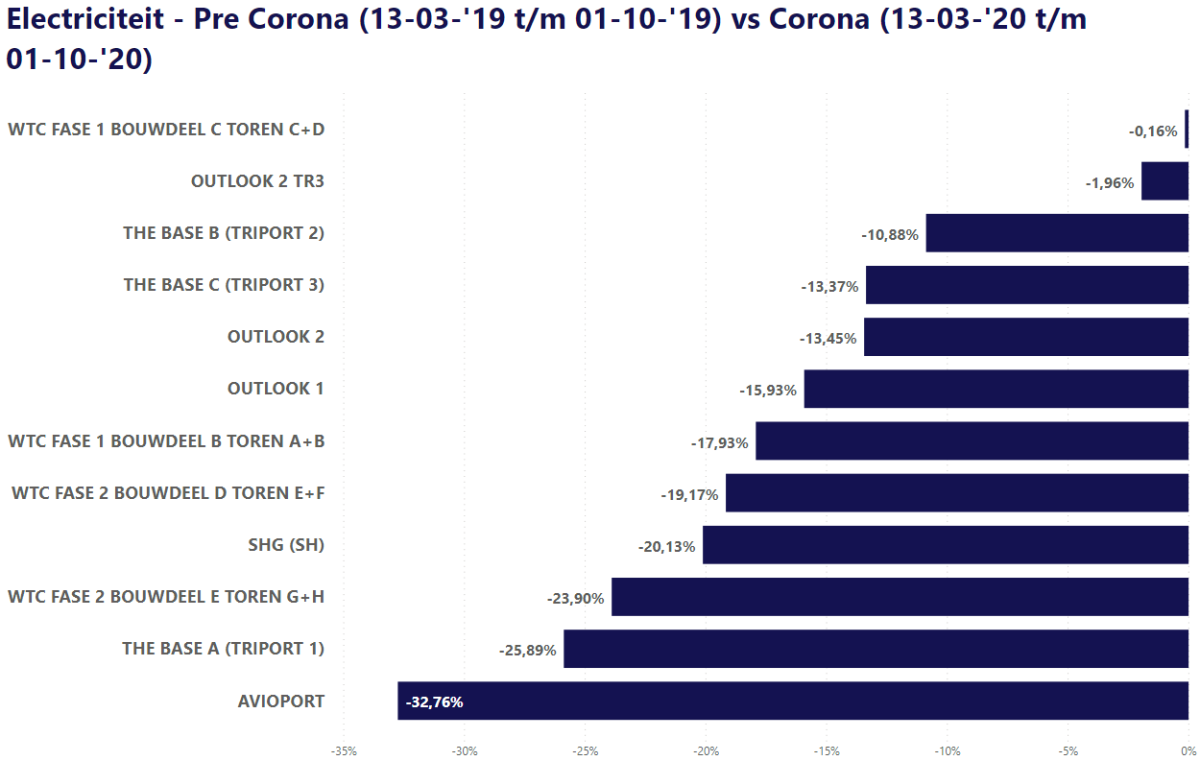
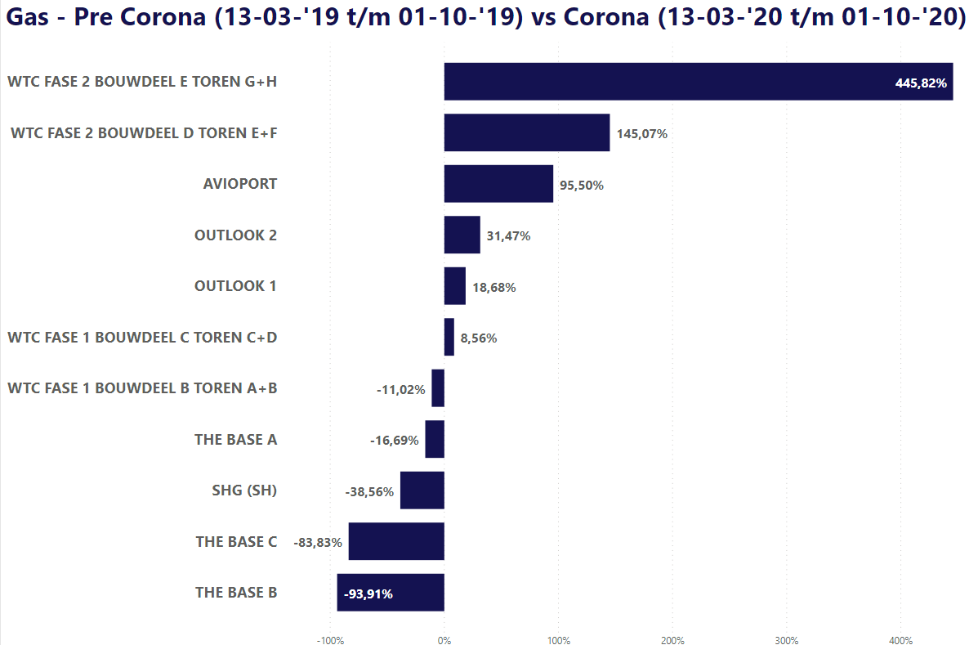
Data insight: Energy Consumption
Question 2:
What has happened to energy consumption since Covid?
The occupancy rate of office buildings has decreased by about 80% in Covid's time
Energy consumption has decreased in all office buildings, but by a much lower percentage
Gas consumption has decreased in some buildings, but increased in others. At WTC G + H this is extreme,
we can zoom in on that further

Slide 36
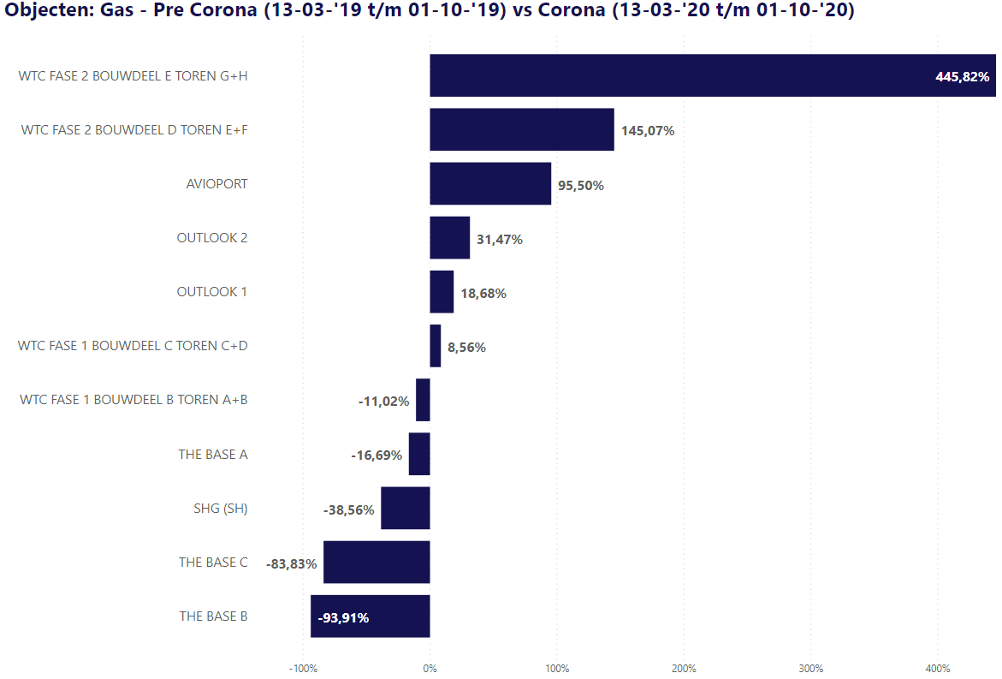
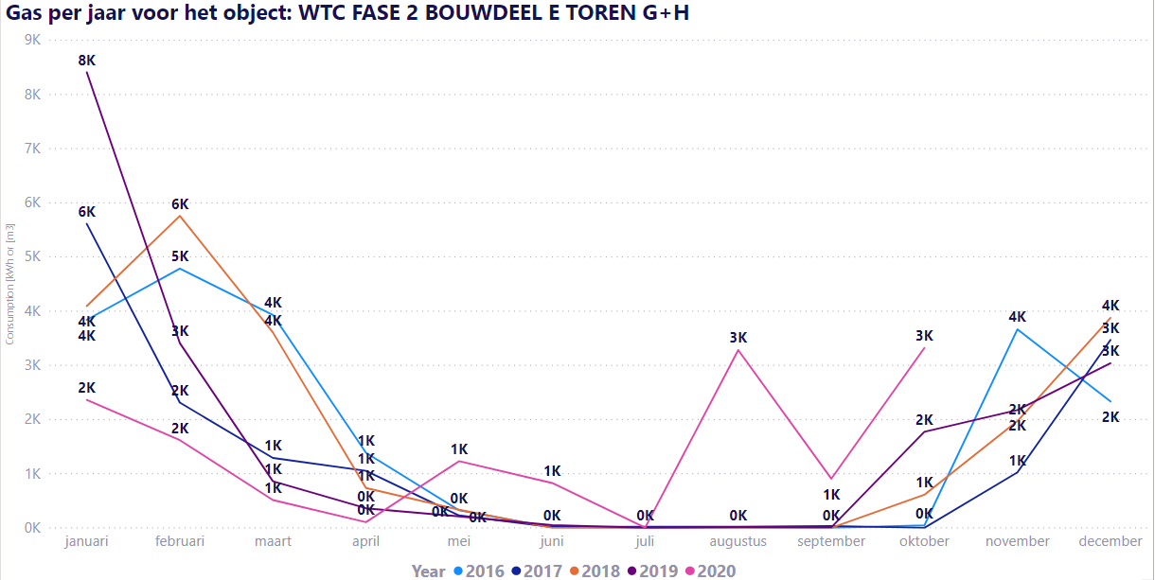
Data insight: Energy Consumption
Question 2:
What has happened to energy consumption since Covid?
Zooming in on WTC tower G&H, we see a clear increase in gas consumption in the summer of 2020
This pattern is exceptional: we don't see this in the other buildings

Slide 37
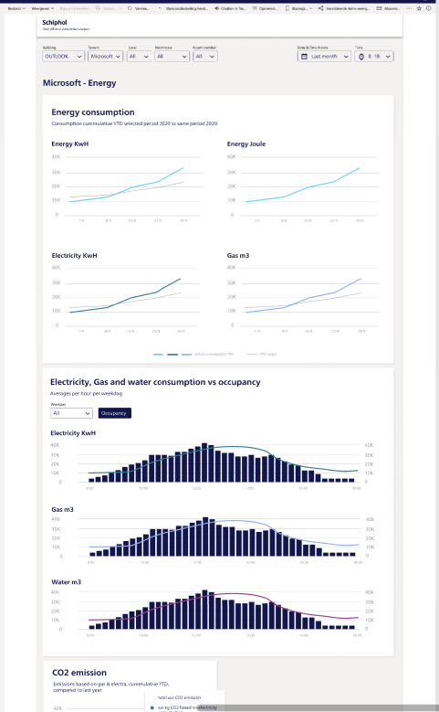
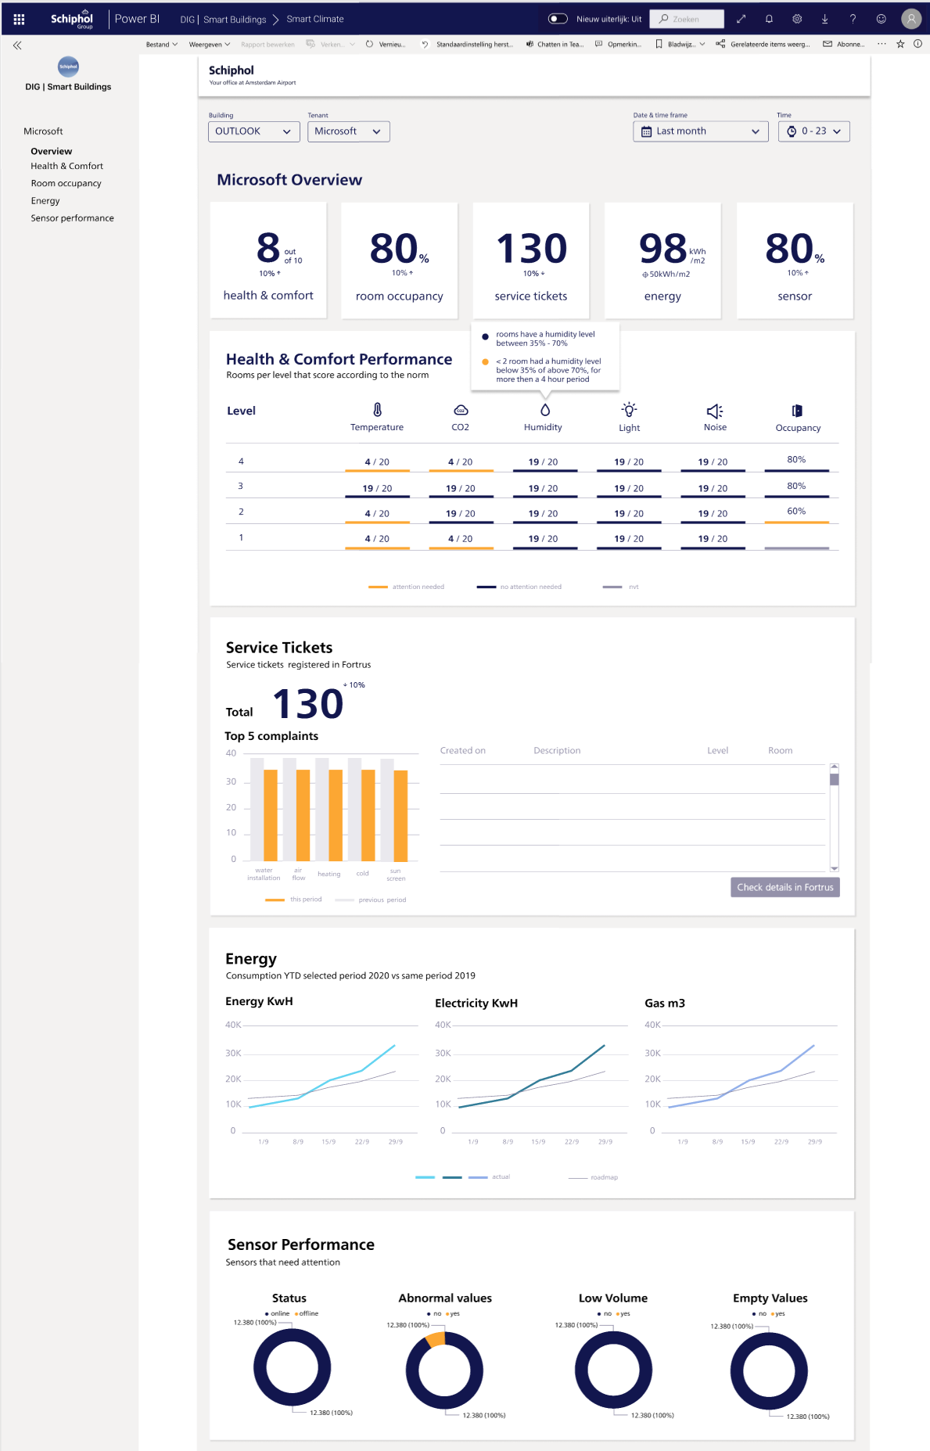
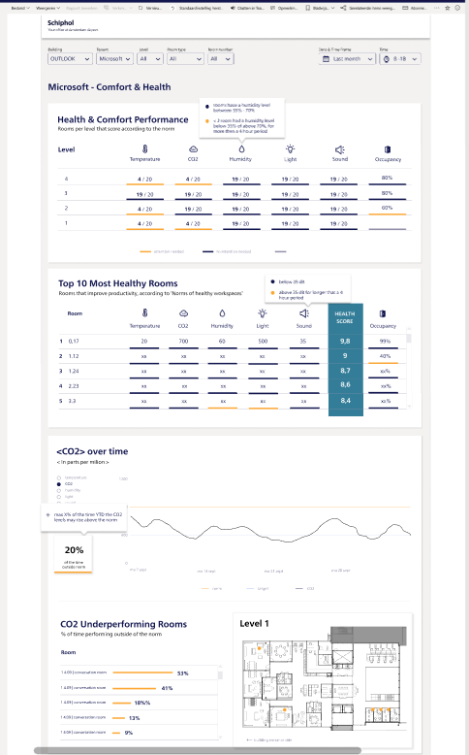
Schiphol Smart Building Scorecard
Building overview page for high on insight into the building (or tenants part) performance on:
Health & Comfort
Service tickets
Energy consumption
Sensor performance
in-depth pages
by theme, to further examine the performance in detail
37

Slide 38

Smart Building Big Data Solution Maturity
IMPACT
Building Performance Business Performance
SYSTEMS
Building Systems Multiple Systems
DATA
Structured Data Unstructured Data
ANALYTICS
Decriptive Analytics Predictive/Presriptive Analytics
Product / Service Innovations
Workplace Productivity & Collaboration
Service Personalisation
Virtual Assistents
Employee Wellness
Behaviour & Emotion Analytics
IT / OT &Smart City Integration
Building Data Monetization
Level 3
Innovation & Differentiation
Predictive Analytics
Occupancy Analytics / Space Optimization
Demand Respons & Smart Grid Integrations
Movement Analytics
Business Systems Integrations & Mobility
Wayfinding, Indoor Mapping & Navigation
Building Portfolio Data Management
Level 2
Optimization
Energy Management
Building Systems Management
Safety & Security
Level 1
Operational Efficiency
Combined Value Potential
Complexity / Sophistication
38
Notes:
https://memoori.com/portfolio/towards-data-driven-buildings/

Slide 39
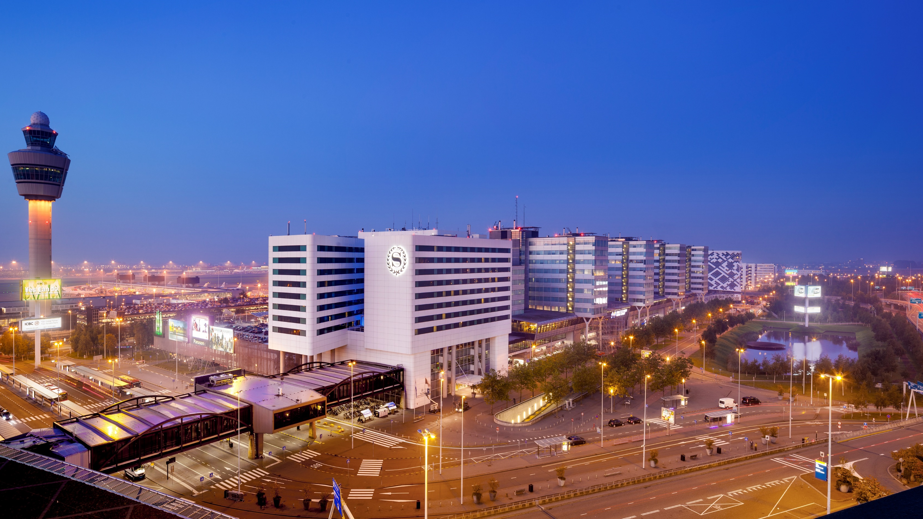
Thanks for your attention
Erik Felëus
Erik.Feleus@Schiphol.nl
Your office at Amsterdam Airport

